Slide 1
N-gram Models

Slide 2
Roadmap
n-gram models
  Motivation
Basic n-grams
  Markov assumptions
Coping with sparse data
  Smoothing, Backoff
Evaluating the model
  Entropy and Perplexity

Slide 3
Information & Communication
Shannon (1948)
Perspective:
  Message selected from possible messages
    Number (or function of #) of messages measure of information produced by selecting that message
    Logarithmic measure
      Base 2: # of bits

Slide 4
Probabilistic Language Generation
Coin-flipping models
  A sentence is generated by a randomized algorithm
    The generator can be in one of several “states”
    Flip coins to choose the next state.
    Flip other coins to decide which letter or word to output

Slide 5
Shannon’s Generated Language
1. Zero-order approximation:
  XFOML RXKXRJFFUJ ZLPWCFWKCYJ FFJEYVKCQSGHYD QPAAMKBZAACIBZLHJQD
2. First-order approximation:
  OCRO HLI RGWR NWIELWIS EU LL NBNESEBYA TH EEI ALHENHTTPA OOBTTVA NAH RBL
3. Second-order approximation:
  ON IE ANTSOUTINYS ARE T INCTORE ST BE S DEAMY ACHIND ILONASIVE TUCOOWE AT TEASONARE FUSO TIZIN ANDY TOBE SEACE CTISBE

Slide 6
Shannon’s Word Models
1. First-order approximation:
  REPRESENTING AND SPEEDILY IS AN GOOD APT OR COME CAN DIFFERENT NATURAL HERE HE THE A IN CAME THE TO OF TO EXPERT GRAY COME TO FURNISHES THE LINE MESSAGE HAD BE THESE
2. Second-order approximation:
  THE HEAD AND IN FRONTAL ATTACK ON AN ENGLISH WRITER THAT THE CHARACTER OF THIS POINT IS THEREFORE ANOTHER METHOD FOR THE LETTERS THAT THE TIME OF WHO EVER TOLD THE PROBLEM FOR AN UNEXPECTED

Slide 7
N-grams
Perspective:
  Some sequences (words/chars) are more likely than others
  Given sequence, can guess most likely next
Used in
  Speech recognition
  Spelling correction,
  Augmentative communication
  Language Identification
  Information Retrieval

Slide 8
Corpus Counts
Estimate probabilities by counts in large collections of text/speech
Issues:
  Wordforms (surface) vs lemma (root)
  Case? Punctuation? Disfluency?
  Type (distinct words) vs Token (total)

Slide 9
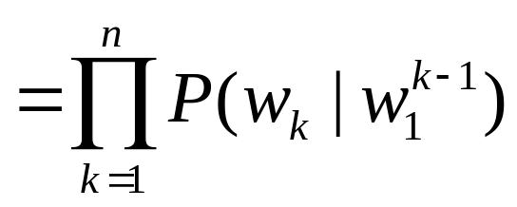
Basic N-grams
Most trivial: 1/#tokens: too simple!
Standard unigram: frequency
  # word occurrences/total corpus size
    E.g. the=0.07; rabbit = 0.00001
  Too simple: no context!
Conditional probabilities of word sequences

Slide 10
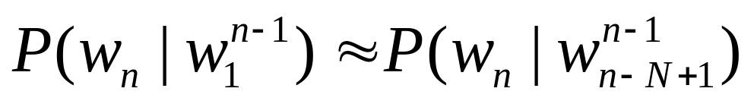
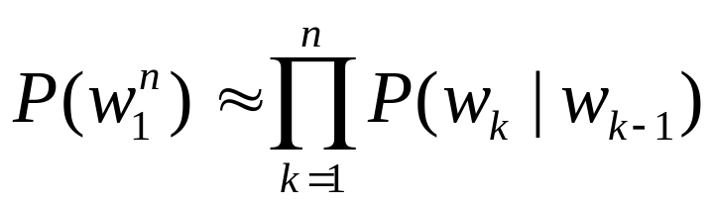
Markov Assumptions
Exact computation requires too much data
Approximate probability given all prior wds
  Assume finite history
  Bigram: Probability of word given 1 previous
    First-order Markov
  Trigram: Probability of word given 2 previous
N-gram approximation
Bigram sequence

Slide 11
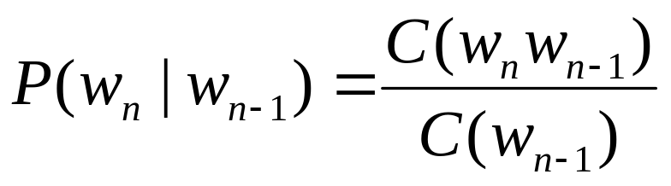
Issues
Relative frequency
  Typically compute count of sequence
    Divide by prefix
Corpus sensitivity
  Shakespeare vs Wall Street Journal
    Very unnatural
Ngrams
  Unigram: little; bigrams: colloc; trigrams:phrase

Slide 12
Sparse Data Issues
Zero-count n-grams
  Problem: Not seen yet! Not necessarily impossible..
  Solution: Estimate probabilities of unseen events
Two strategies:
  Smoothing
    Divide estimated probability mass
  Backoff
    Guess higher order n-grams from lower

Slide 13
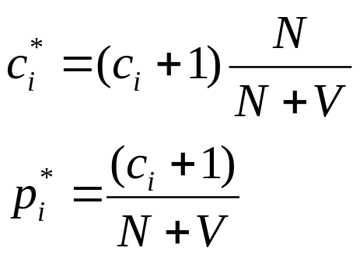
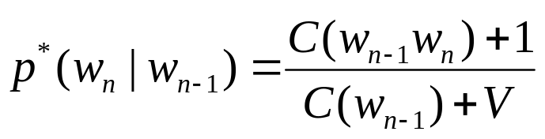
Smoothing out Zeroes
Add-one smoothing
  Simple: add 1 to all counts -> no zeroes!
  Normalize by count and vocabulary size
Unigrams:
  Adjusted count:
  Adjusted probability
Bigrams:
  Adjusted probability
Problem: Too much weight on (former) zeroes

Slide 14

Backoff
Idea: If no tri-grams, estimate with bigrams
E.g.
=
=
Deleted interpolation:
  Replace α’s with λ’s that are trained for word contexts

Slide 15
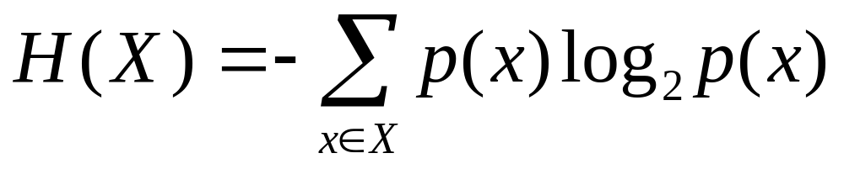
Toward an Information Measure
Knowledge: event probabilities available
Desirable characteristics: H(p1,p2,…,pn)
  Continuous in pi
  If pi equally likely, monotonic increasing in n
    If equally likely, more choice w/more elements
  If broken into successive choices, weighted sum
Entropy: H(X): X is a random var, p: prob fn

Slide 16
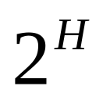
Evaluating n-gram models
Entropy & Perplexity
  Information theoretic measures
  Measures information in grammar or fit to data
  Conceptually, lower bound on # bits to encode
Entropy: H(X): X is a random var, p: prob fn
Perplexity:
  Weighted average of number of choices

Slide 17
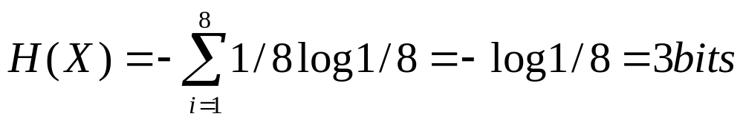
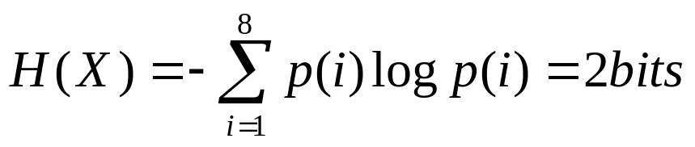
Computing Entropy
Picking horses (Cover and Thomas)
Send message: identify horse - 1 of 8
  If all horses equally likely, p(i) = 1/8
  Some horses more likely:
    1: ½; 2: ¼; 3: 1/8; 4: 1/16; 5,6,7,8: 1/64

Slide 18
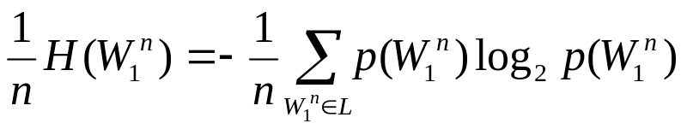
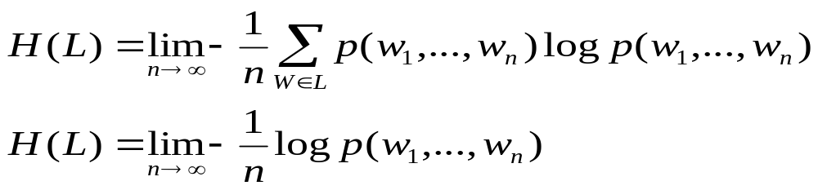
Entropy of a Sequence
Basic sequence
Entropy of language: infinite lengths
  Assume stationary & ergodic

Slide 19
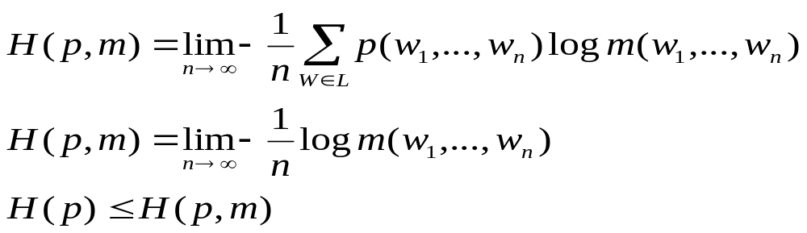
Cross-Entropy
Comparing models
  Actual distribution unknown
  Use simplified model to estimate
    Closer match will have lower cross-entropy

Slide 20
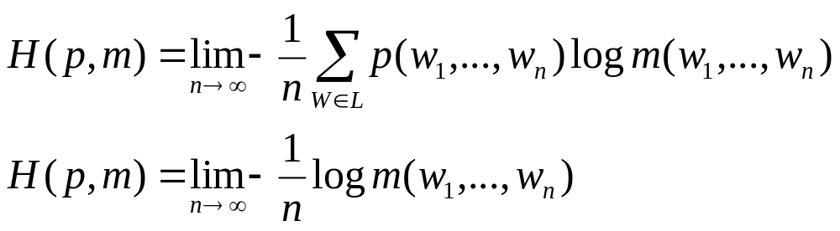
Cross-Entropy
Comparing models
  Actual distribution unknown
  Use simplified model to estimate
    Closer match will have lower cross-entropy

Slide 21
Perplexity Model Comparison
Compare models with different history
Train models
  38 million words – Wall Street Journal
Compute perplexity on held-out test set
  1.5 million words (~20K unique, smoothed)
N-gram Order | Perplexity
  Unigram | 962
  Bigram | 170
  Trigram | 109

Slide 22
Does the model improve?
Compute probability of data under model
  Compute perplexity
Relative measure
  Decrease toward optimum?
  Lower than competing model?
Iter | 0 | 1 | 2 | 3 | 4 | 5 | 6 | 9 | 10
P(data) | 9^-19 | 1^-16 | 2^-16 | 3^-16 | 4^-16 | 4^-16 | 4^-16 | 5^-16 | 5^-16
Perplex | 3.393 | 2.95 | 2.88 | 2.85 | 2.84 | 2.83 | 2.83 | 2.8272 | 2.8271

Slide 23
Entropy of English
Shannon’s experiment
  Subjects guess strings of letters, count guesses
  Entropy of guess seq = Entropy of letter seq
  1.3 bits; Restricted text
Build stochastic model on text & compute
  Brown computed trigram model on varied corpus
  Compute (per-char) entropy of model
  1.75 bits

Slide 24
Using N-grams
Language Identification
  Take text samples
    English, French, Spanish, German
  Build character tri-gram models
  Test Sample: Compute maximum likelihood
    Best match is chosen language
Authorship attribution

